Slide 1
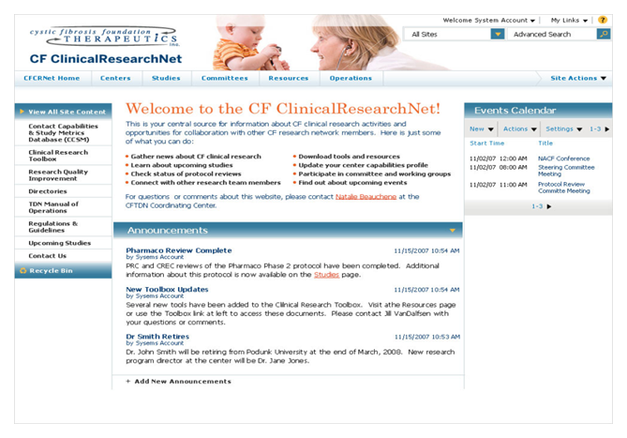
Children's Hospital Trial Assignments
The Challenge
Children’s Hospital Therapeutic Development Network manages clinical trials for The Cystic Fibrosis Foundation. The hospital needed a way to increase the speed and quality of patient assignments to clinical trials. Children’s Hospital wanted a collaborative software solution that would make this process more efficient across various care centers while improving the overall quality of patient care.
What We Did
• Provided business management consulting to understand business processes
• Implemented Microsoft SharePoint 2007 Portal Extranet hosted in a medium farm with ISA Server <br></br>
• Collaborated with the IT department at The Cystic Fibrosis Foundation in order to successfully deploy the CFCRNet Portal
Results
The resulting portal increased the speed and quality of the collaboration process by 15-25%

